Slide 1
Terminology
Sungjoon Choi
(sungjoon.choi@cpslab.snu.ac.kr)

Slide 2
Terminologies are Important

Slide 3
Input Data

Slide 4
Output / Class / Label
Cat
[1 0 0 0]
Dog
[0 1 0 0]
Cow
[0 0 1 0]
Horse
[0 0 0 1]

Slide 5
One-hot coding
Cat
[1 0 0 0]
Dog
[0 1 0 0]
Cow
[0 0 1 0]
Horse
[0 0 0 1]

Slide 6


Training / Learning

Slide 7
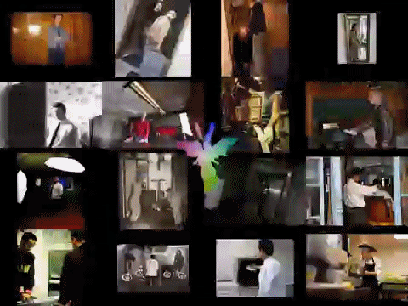
Dataset
Training Data
Validation Data
(Cross-validation)
Test Data

Slide 8
Neuron

Slide 9
Perceptron
Notes:
논리연산 – 컴퓨터. 즉석에서 문제풀어보기

Slide 10
Basic single layer network
1
2
W
4
Weight
0
+
ReLu
Input
b
Output
Bias

Slide 11
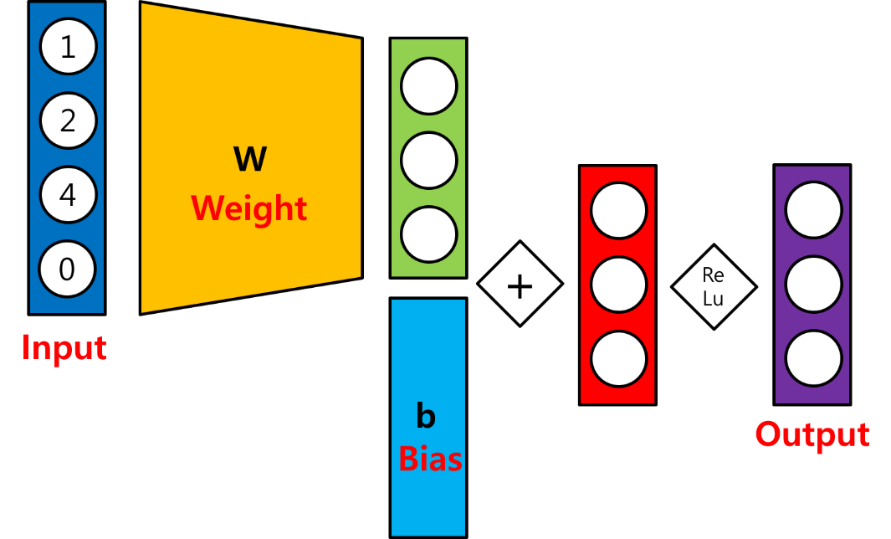
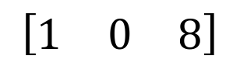
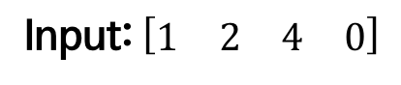
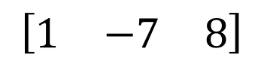
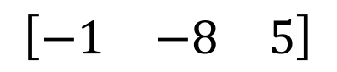
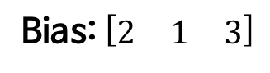
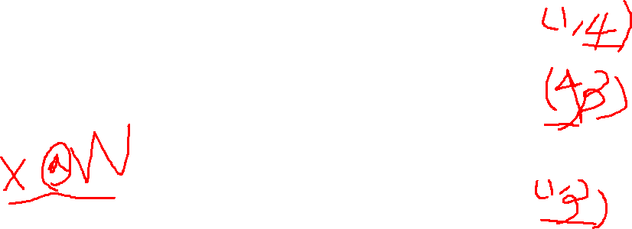
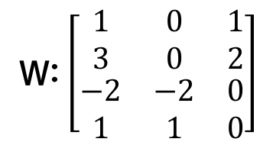
Basic single layer network
Input: $\left[\begin{matrix}\begin{matrix}1 & 2\end{matrix} & \begin{matrix}4 & 0\end{matrix}\end{matrix}\right]$
W: $\left[\begin{matrix}\begin{matrix}\begin{matrix}1 \\ 3\end{matrix} \\ \begin{matrix}−2 \\ 1\end{matrix}\end{matrix} & \begin{matrix}\begin{matrix}0 \\ 0\end{matrix} \\ \begin{matrix}−2 \\ 1\end{matrix}\end{matrix} & \begin{matrix}\begin{matrix}1 \\ 2\end{matrix} \\ \begin{matrix}0 \\ 0\end{matrix}\end{matrix}\end{matrix}\right]$
Bias: $\left[\begin{matrix}2 & 1 & 3\end{matrix}\right]$
$$\left[\begin{matrix}−1 & −8 & 5\end{matrix}\right]$$
$$\left[\begin{matrix}1 & −7 & 8\end{matrix}\right]$$
$$\left[\begin{matrix}1 & 0 & 8\end{matrix}\right]$$

Slide 12
(Neural) Network
Notes:
UAT 때문에 deep learning이 늦어졌다?

Slide 13
Multi-Layer Perceptron

Slide 14
Activation Function

Slide 15
Epoch / Batch size / Iteration
One epoch: one forward and backward pass of all training data
Batch size: the number of training examples in one forward and backward pass
One iteration: number of passes
If we have 55,000 training data, and the batch size is 1,000. Then, we need 55 iterations to complete 1 epoch.

Slide 16
Cost function
This is just a function that we want to minimize.
There is no guarantee that it will bring us to the best solution!
It should be differentiable!

Slide 17
MNIST (Mixed National Institute of Standards and Technology)

Slide 18
Modern CNNs
Sungjoon Choi
(sungjoon.choi@cpslab.snu.ac.kr)

Slide 19
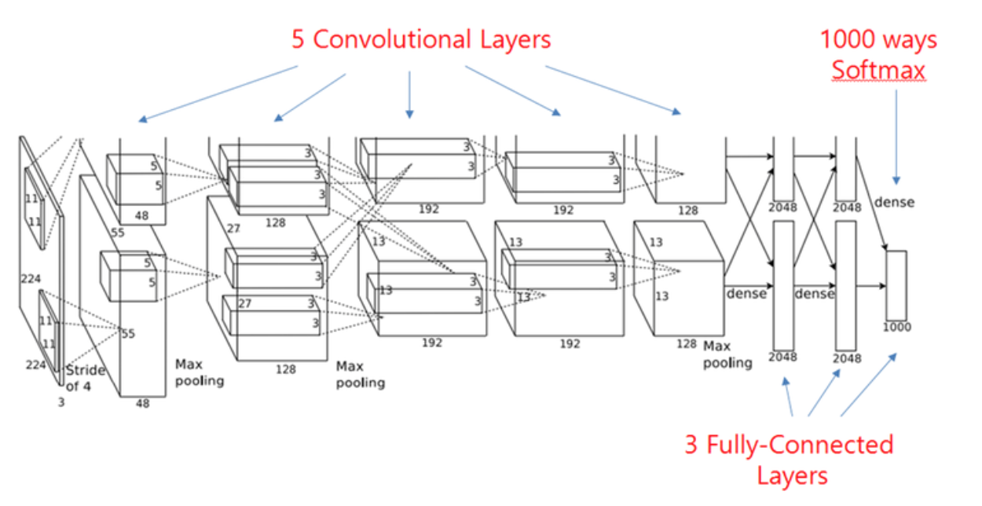
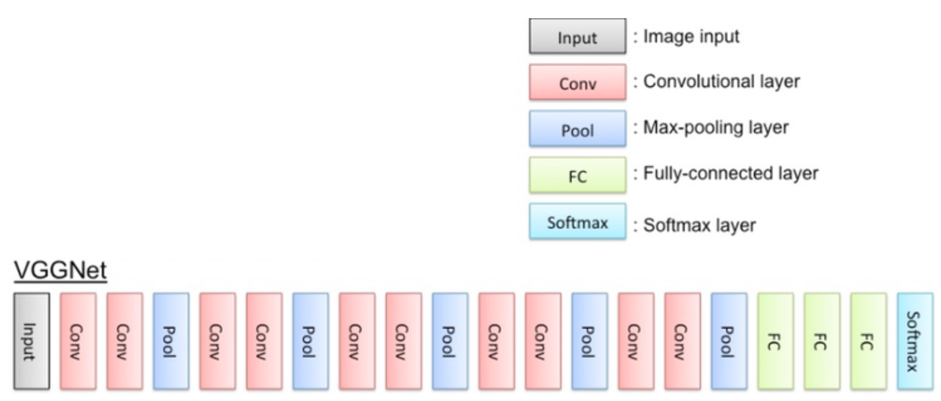
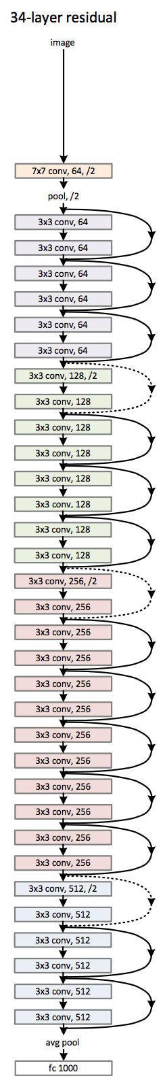
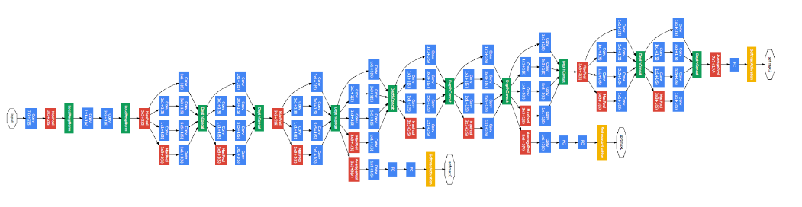
CNN Architectures
AlexNet
VGG
GoogLeNet
ResNet

Slide 20
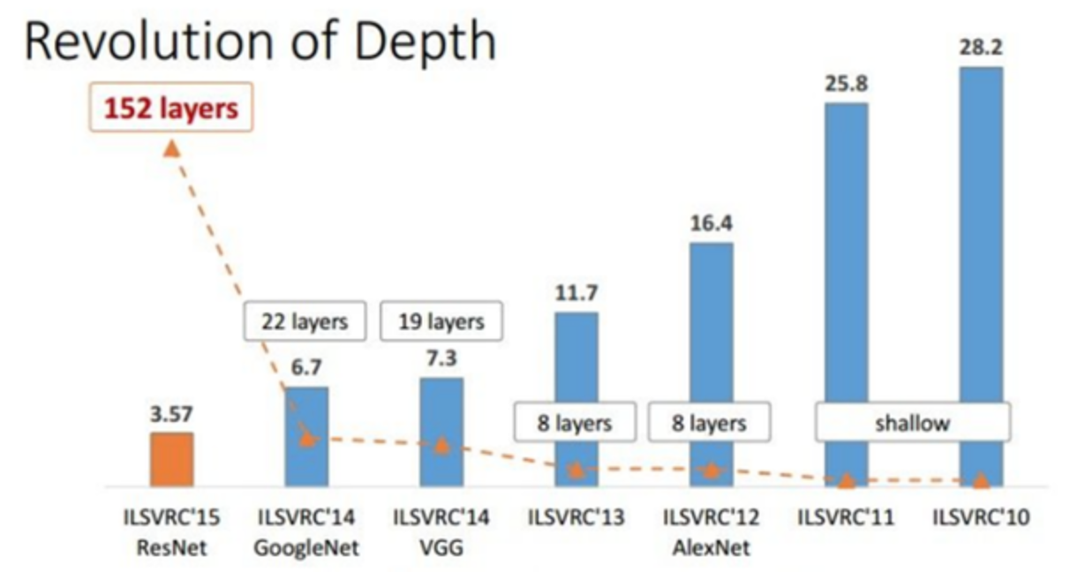
Top-5 Classification Error

Slide 21
AlexNet

Slide 22
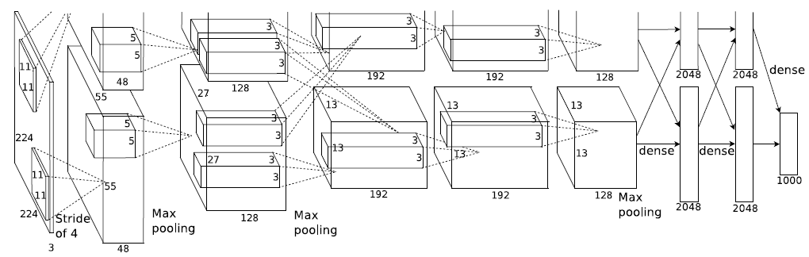

AlexNet
What is the number of parameters?
Why are layers divided into two parts?

Slide 23
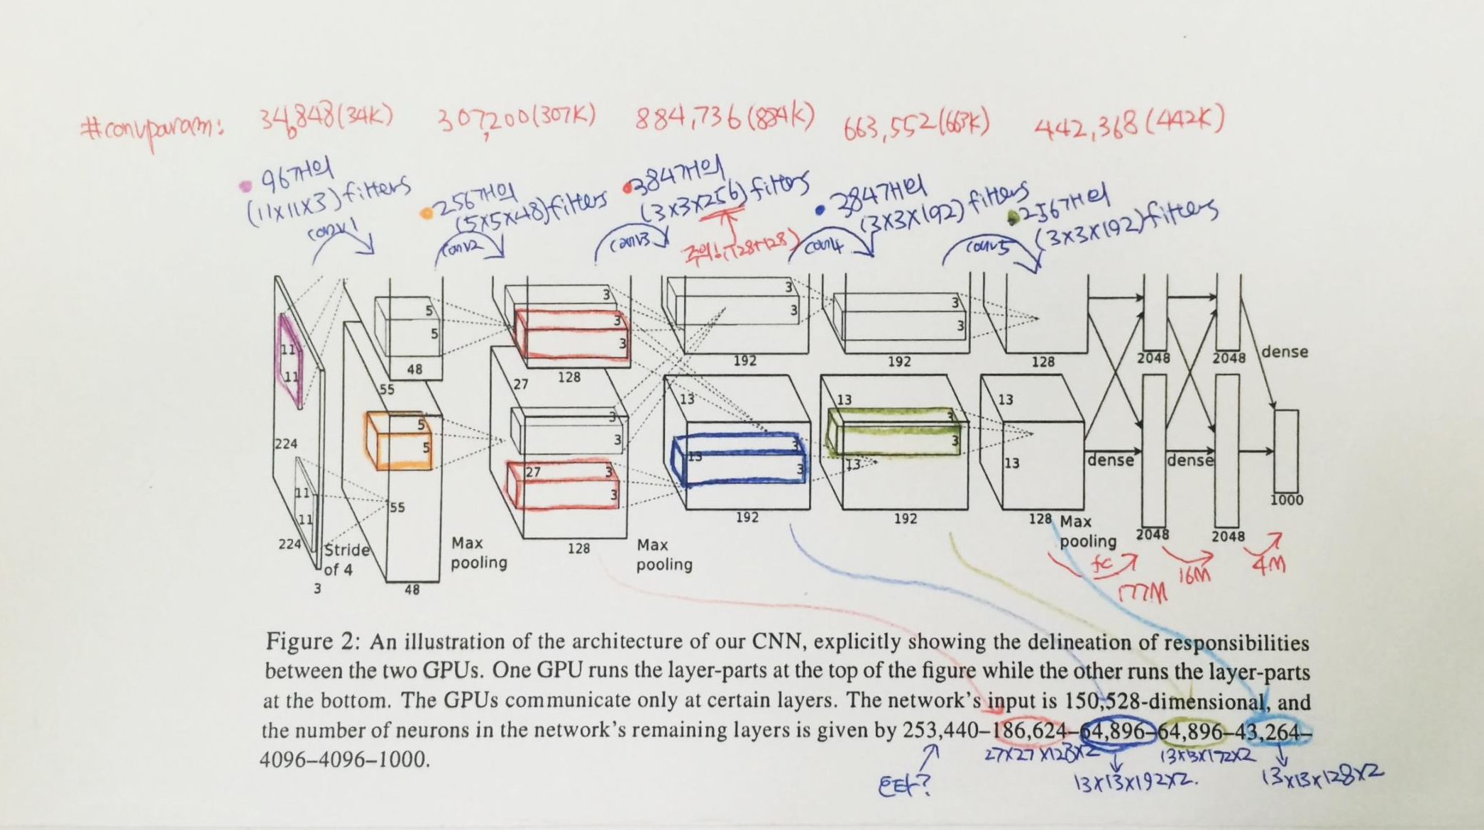
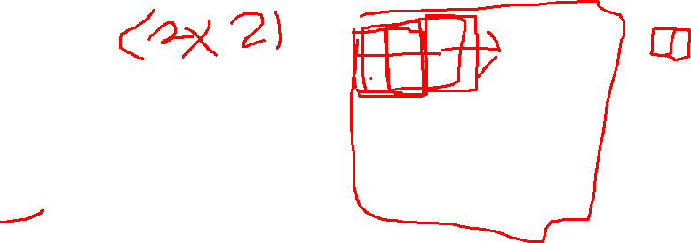
AlexNet

Slide 24
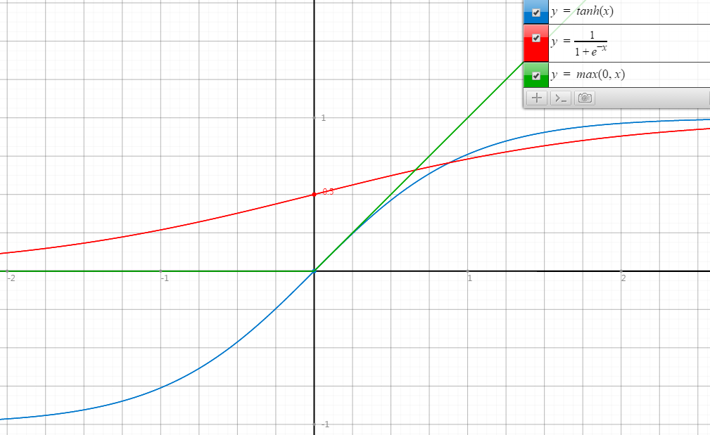
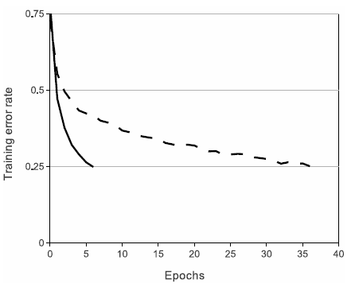
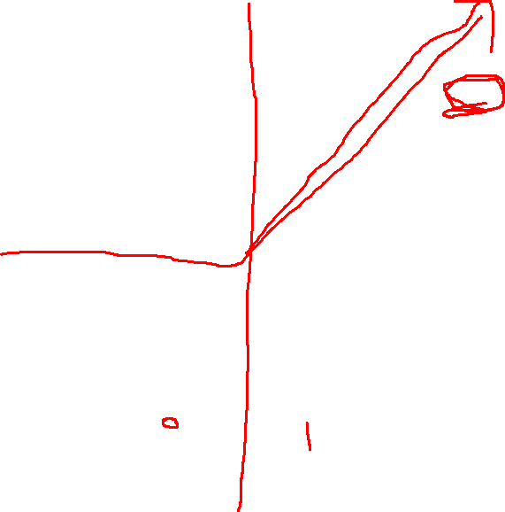
ReLU
Rectified Linear Unit
ReLU
tanh
Faster Convergence!

Slide 25

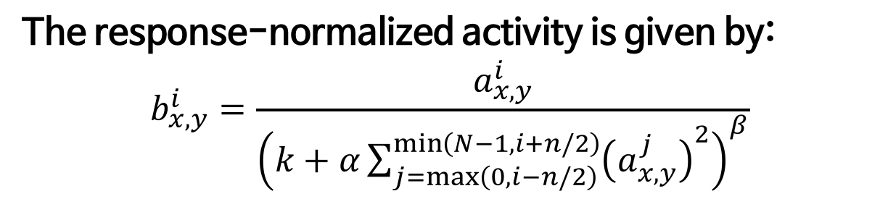
LRN
Local Response Normalization
The response-normalized activity is given by:
$$b_{x,y}^{i}=\frac{a_{x,y}^{i}}{{\left(k+α\sum_{j=\max\left(0, i−n/2\right)}^{\min\left(N−1, i+n/2\right)}{{\left(a_{x,y}^{j}\right)}^{2}}\right)}^{β}}$$
It implements a form of lateral inhibition inspired by real neurons.

Slide 26

Regularization in AlexNet
Main objective is to reduce overfitting.
More details will be handled in next week.
In the AlexNet, two regularization methods are used.
Data augmentation
Dropout

Slide 27
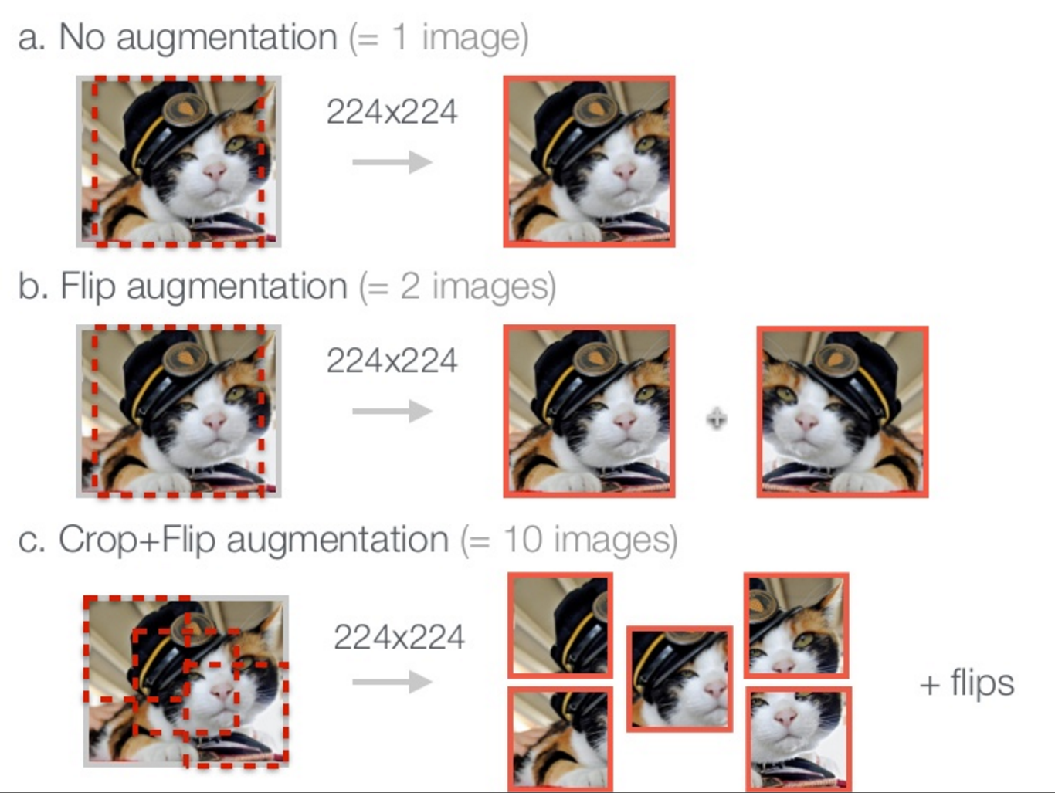
Data augmentation
http://www.slideshare.net/KenChatfield/chatfield14-devil

Slide 28
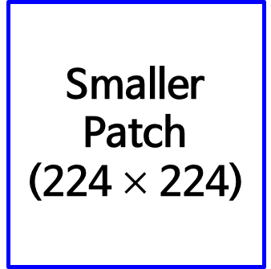

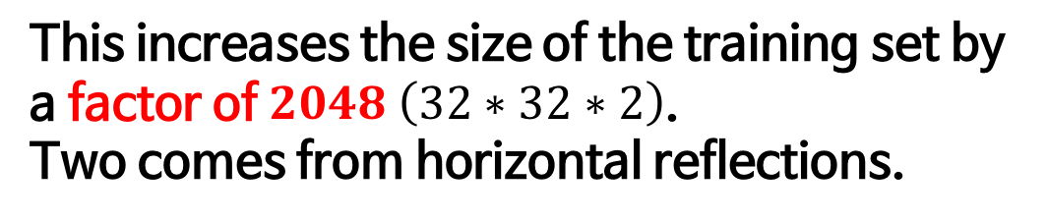
Data augmentation in AlexNet
Original Image
(256 $×$ 256)
Smaller Patch
(224 $×$ 224)
This increases the size of the training set by a factor of $2048 \left(32∗32∗2\right)$.
Two comes from horizontal reflections.

Slide 29
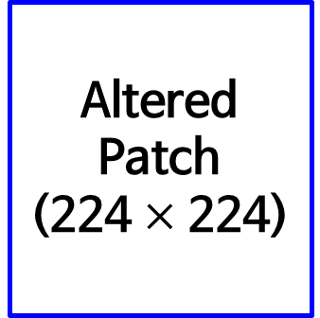
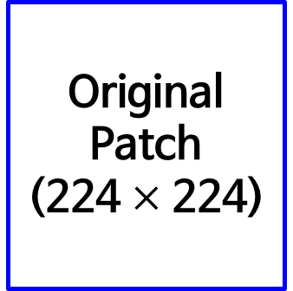
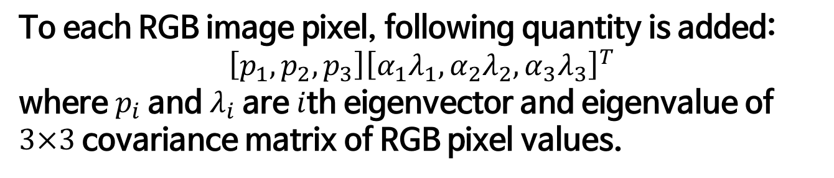
Data augmentation in AlexNet
Original Patch
(224 $×$ 224)
Altered Patch
(224 $×$ 224)
Color variation
To each RGB image pixel, following quantity is added:
$$\left[p_{1}, p_{2}, p_{3}\right]{\left[α_{1}λ_{1},α_{2}λ_{2},α_{3}λ_{3}\right]}^{T}$$
where $p_{i}$ and $λ_{i}$ are $i$th eigenvector and eigenvalue of $3×3$ covariance matrix of RGB pixel values.
Probabilistically, not a single patch will be same at the training phase! (a factor of infinity!)

Slide 30
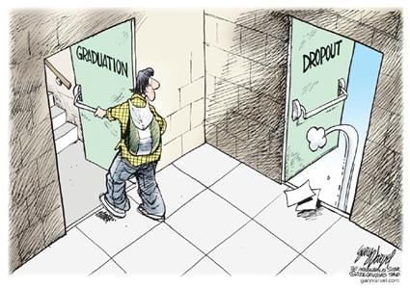

Dropout
Original dropout [1] sets the output of each hidden neuron with certain probability.
In this paper, they simply multiply the outputs by 0.5.
[1] G.E. Hinton, N. Srivastava, A. Krizhevsky, I. Sutskever, and R.R. Salakhutdinov. Improving neural networks by preventing co-adaptation of feature detectors. arXiv, 2012.
http://www.eddyazar.com/the-regrets-of-a-dropout-and-why-you-should-drop-out-too/

Slide 31
Must remember!

Slide 32
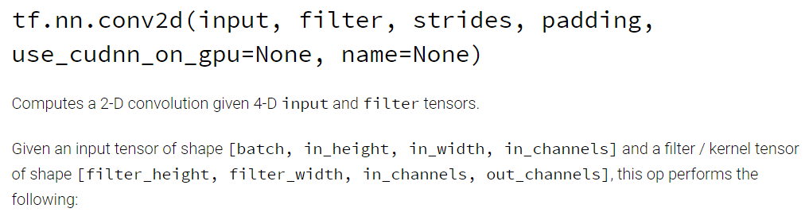
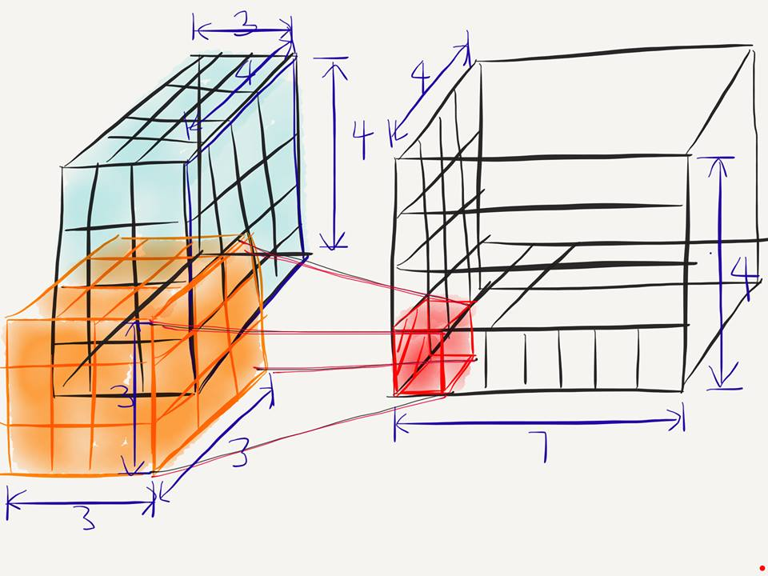
Conv2D
[batch, in_height, in_width, in_chnnel]
[filter_height, filter_width, in_channels, out_channels]
[batch, in_height=4, in_width=4, in_chnnel=3]
[filter_height=3, filter_width=3, in_channels=3, out_channels=7]

Slide 33
Conv2D
[batch, in_height=4, in_width=4, in_chnnel=3]
[filter_height=3, filter_width=3, in_channels=3, out_channels=7]
What is the number of parameters in this convolution layer?
→ $189= 3∗3∗3∗7$

Slide 34
VGG

Slide 35
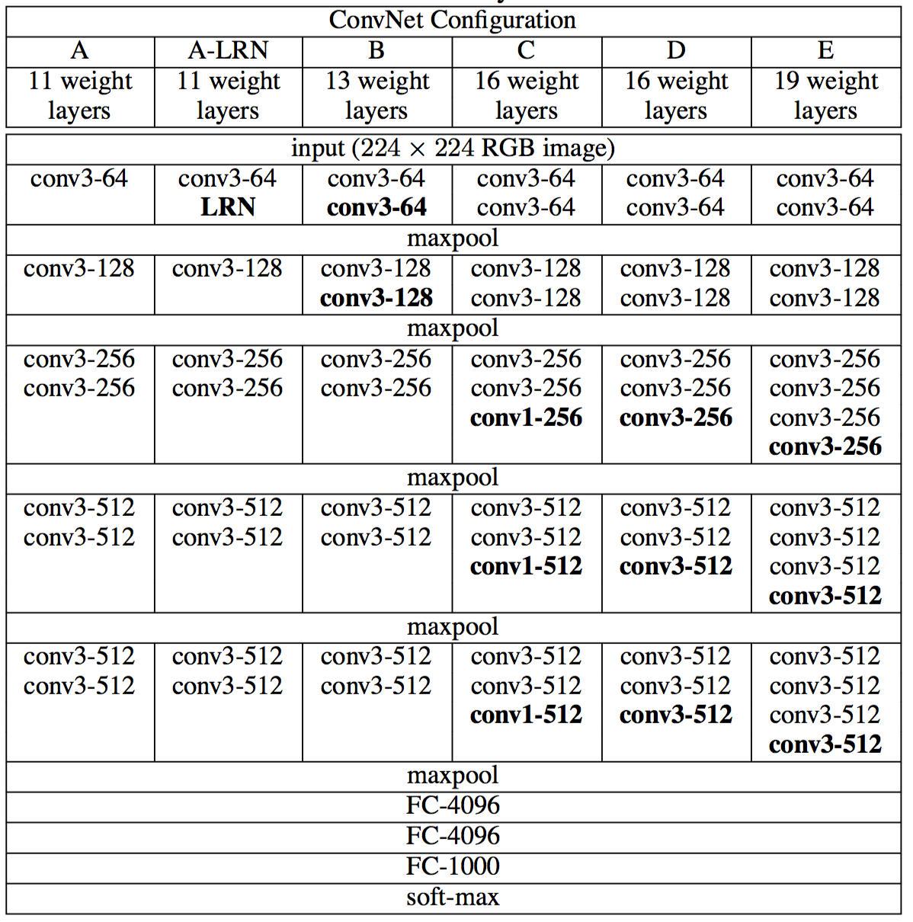
VGG?

Slide 36
GoogLeNet

Slide 37


GoogLeNet

Slide 38
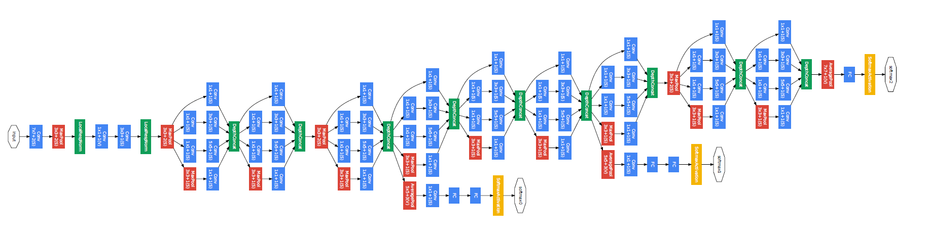
GoogLeNet
22 Layers Deep Network
Efficiently utilized computing resources, “Inception Module”
Significantly outperforms previous methods on ILSVRC 2014

Slide 39
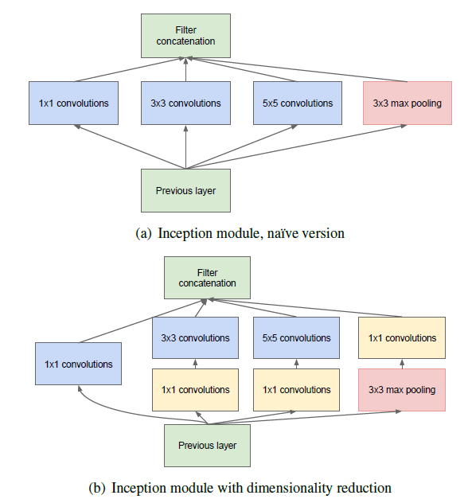
Inception module

Slide 40
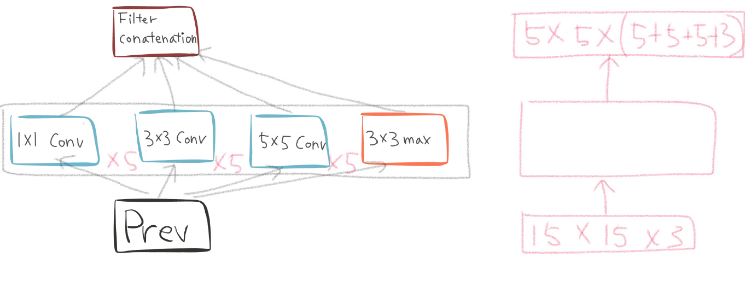
Naïve inception module

Slide 41
Naïve inception module

Slide 42
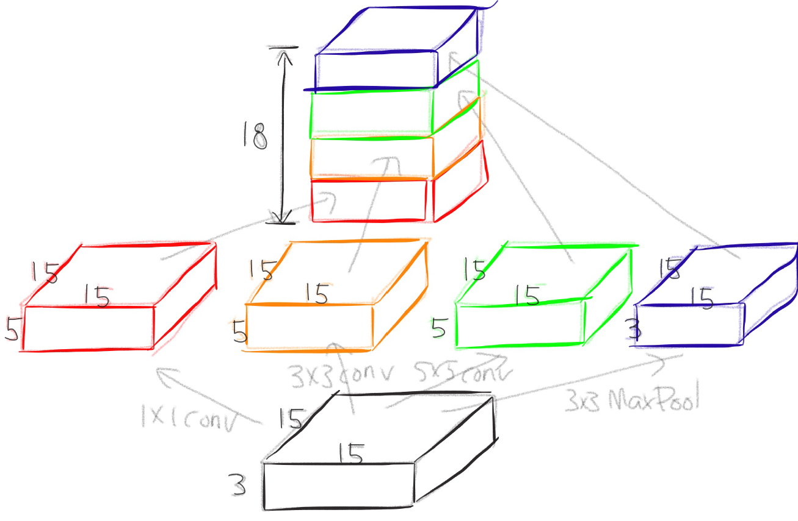
Naïve inception module

Slide 43
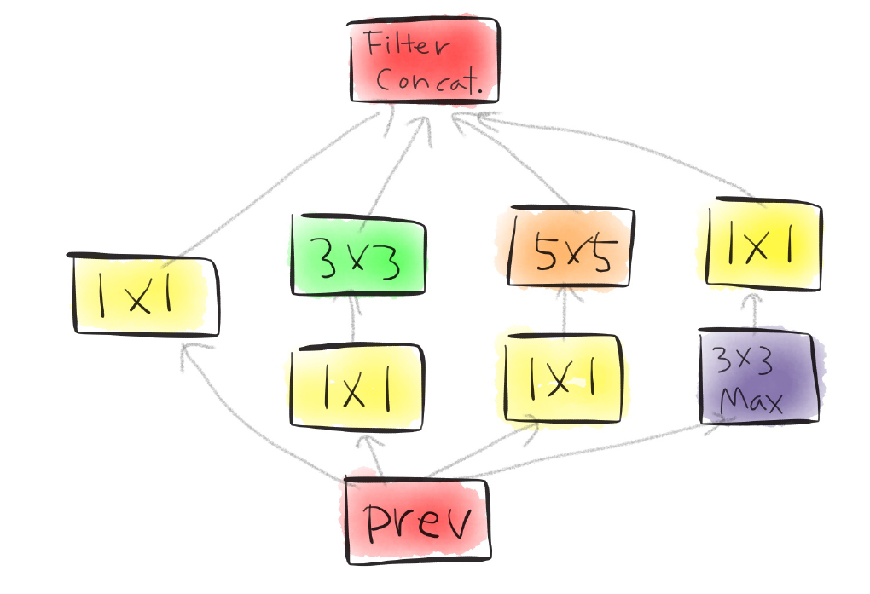
Actual inception module

Slide 44
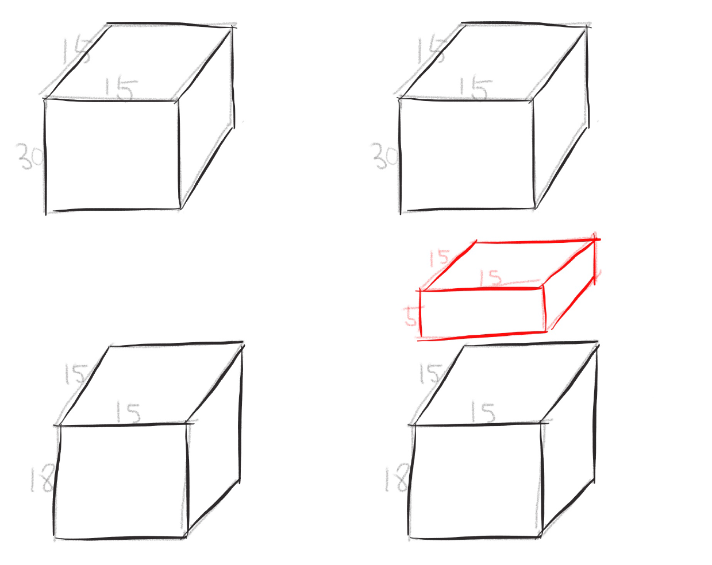
One by one convolution
Notes:
Parameter size 변화 직접 보여주기

Slide 45
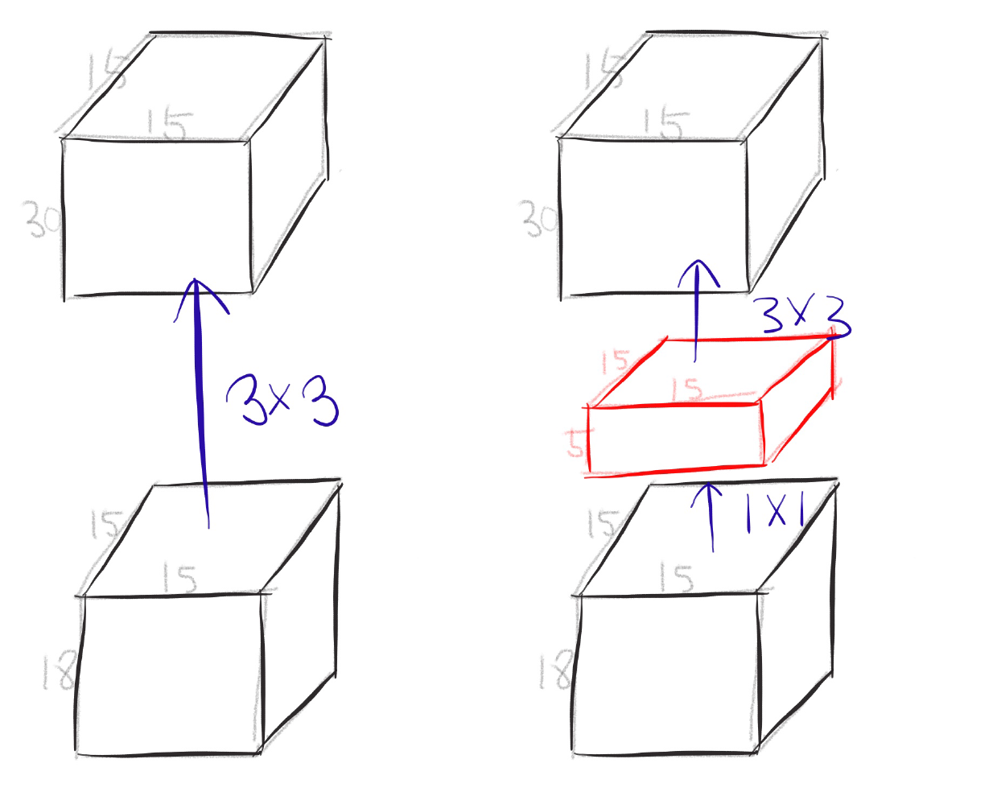
One by one convolution

Slide 46
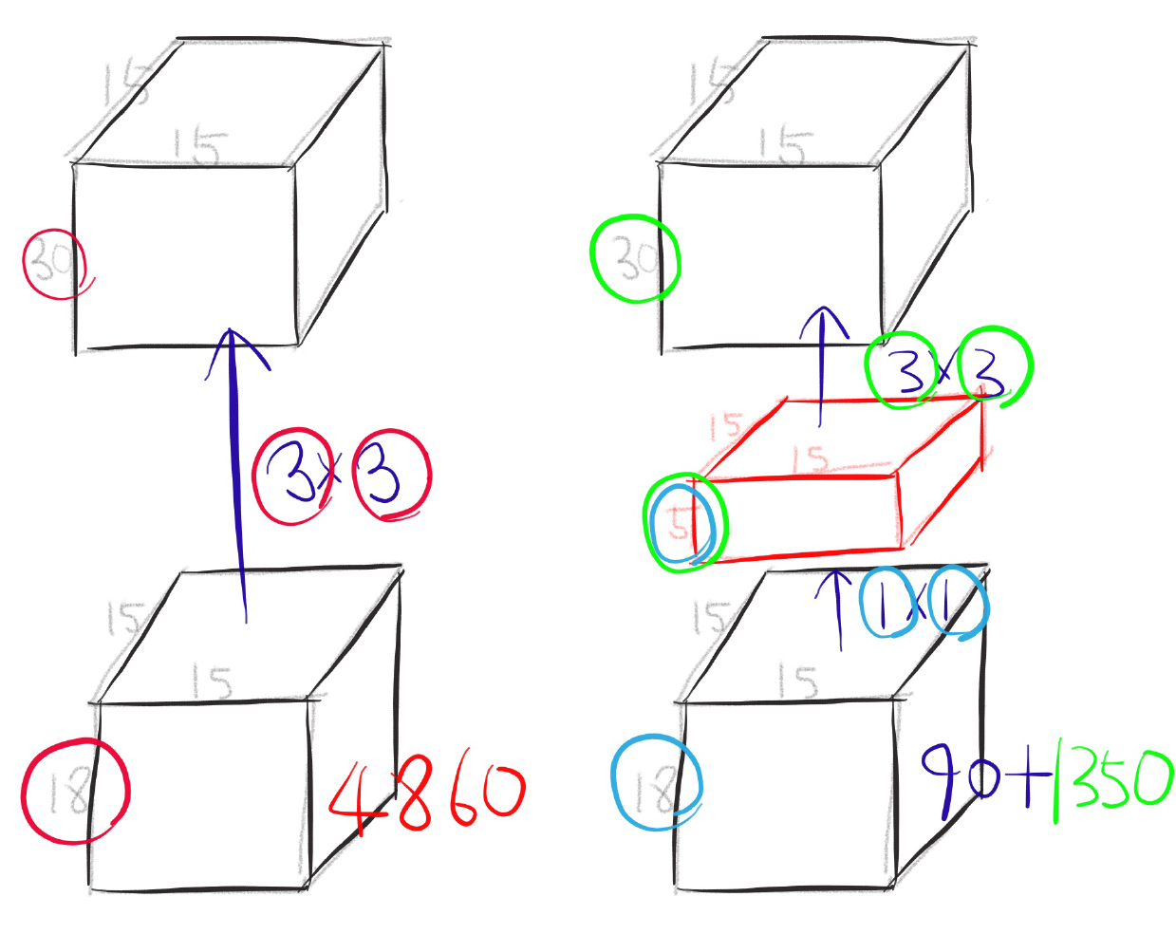
One by one convolution
Notes:
otal params: 2,853,314
Trainable params: 2,847,938
Non-trainable params: 5,376 otal params: 3,189,187
Trainable params: 3,182,147
Non-trainable params: 7,040

Slide 47
GoogLeNet
Network in Network!

Slide 48

Conclusion
Very clever idea of using one by one convolution for dimension reduction!
Other than that...

Slide 49
Inception-v4, Inception-ResNet and the Impact of Residual Connections on Learning

Slide 50
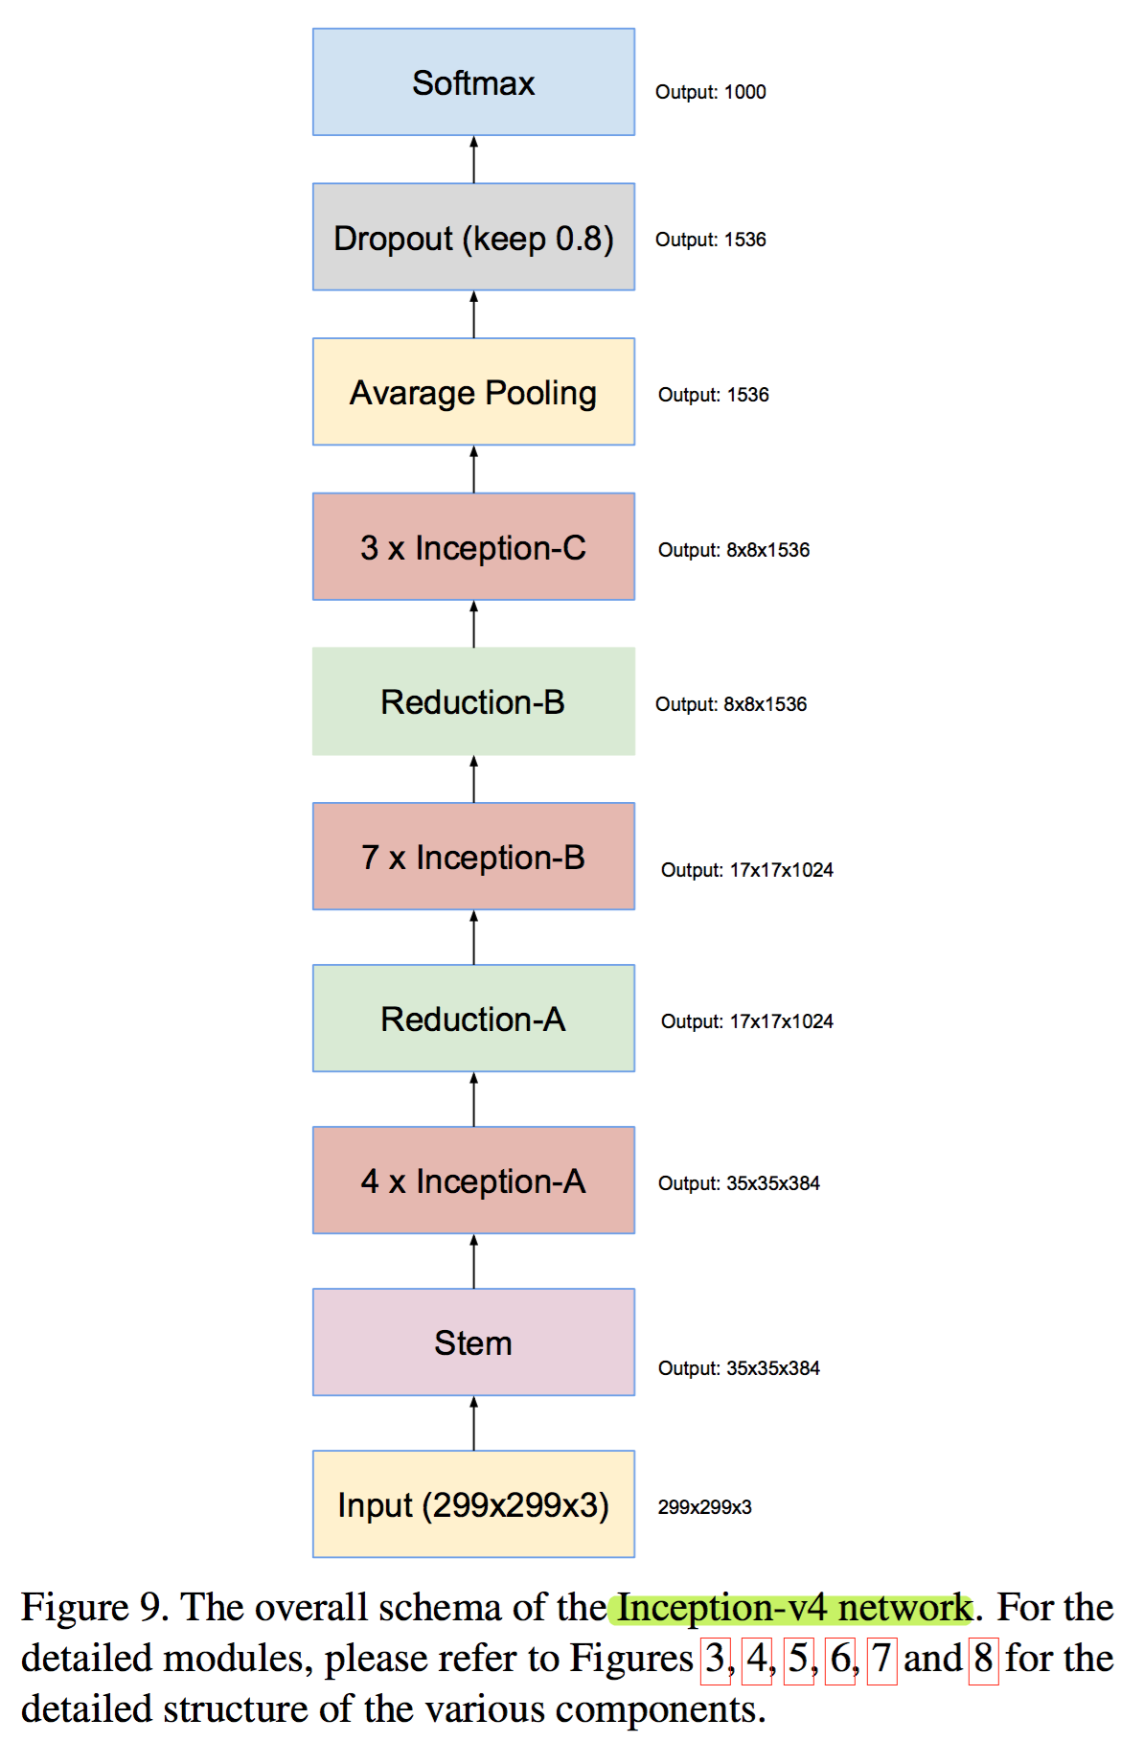
Inception v4

Slide 51
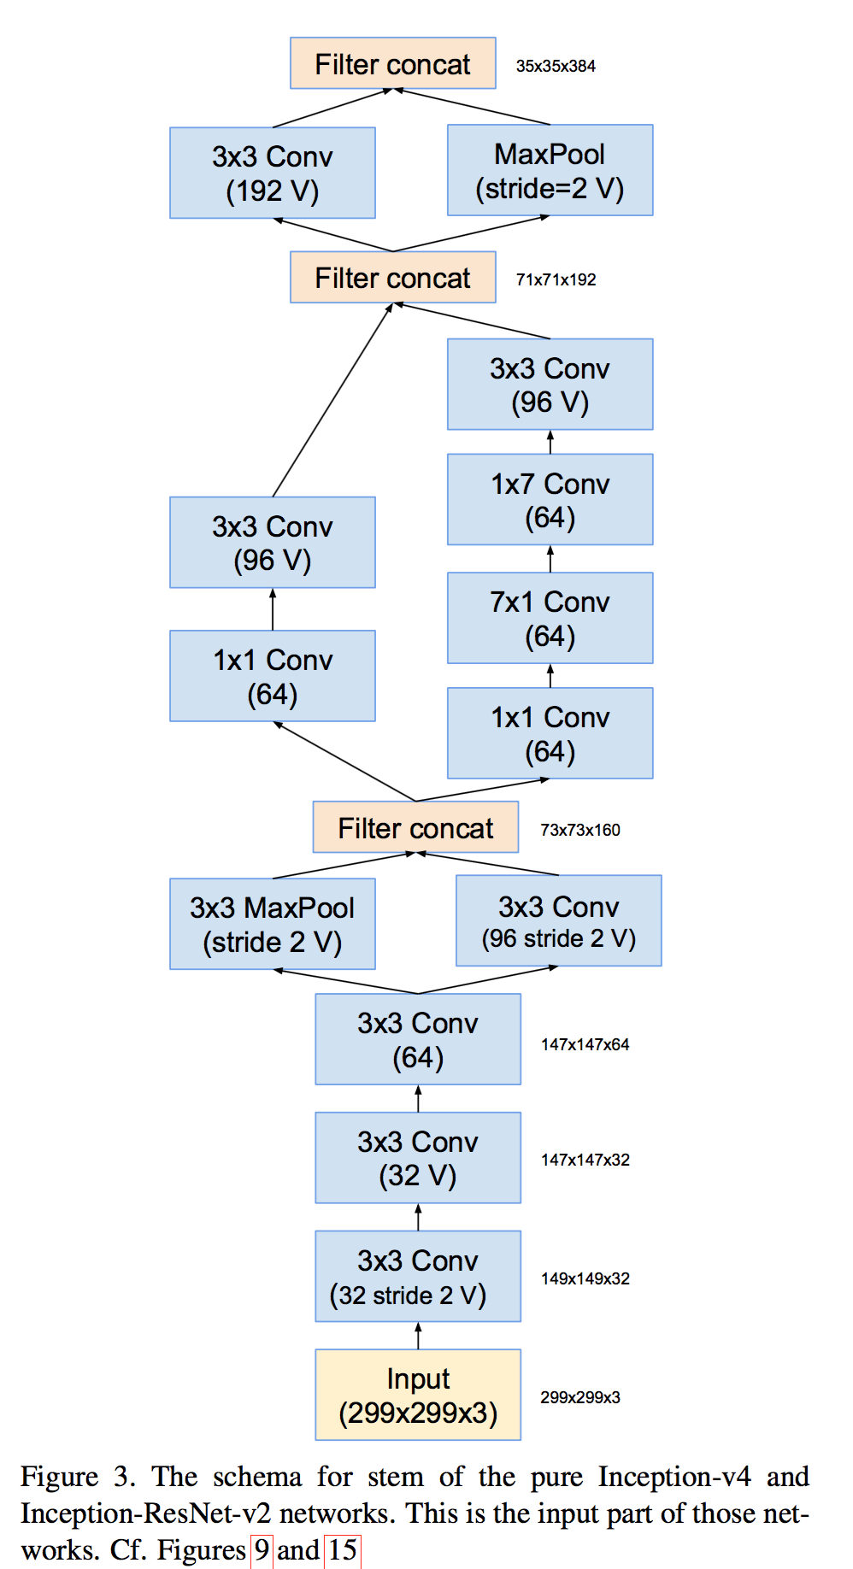
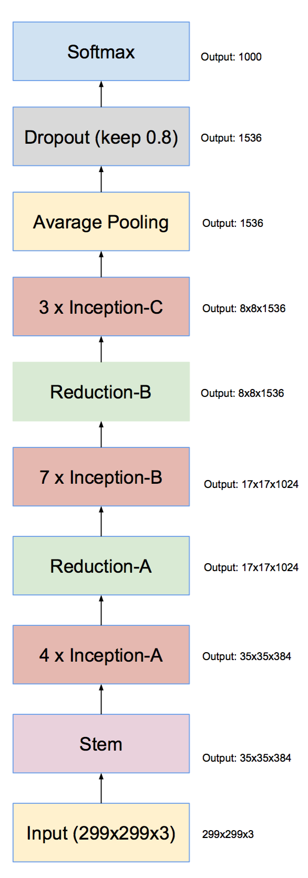
Inception v4

Slide 52
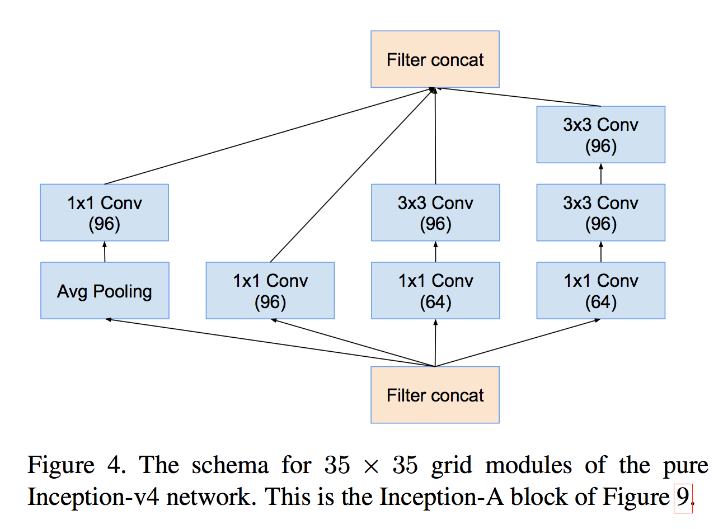
Inception v4

Slide 53
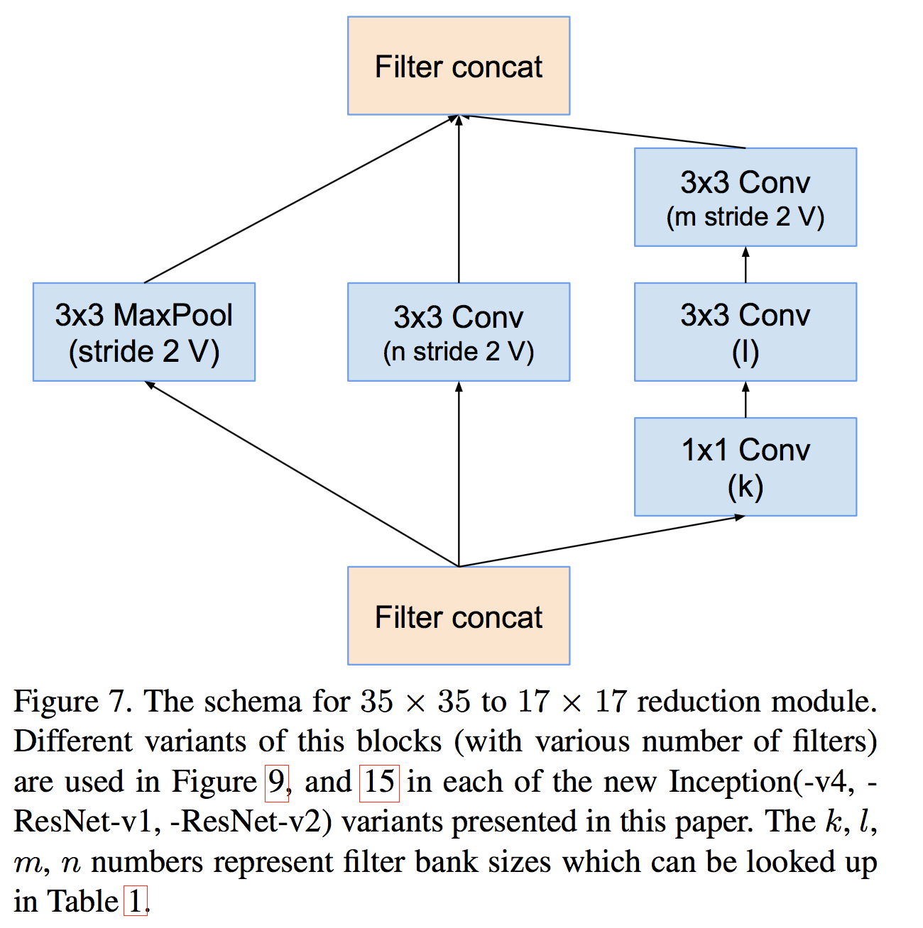
Inception v4

Slide 54
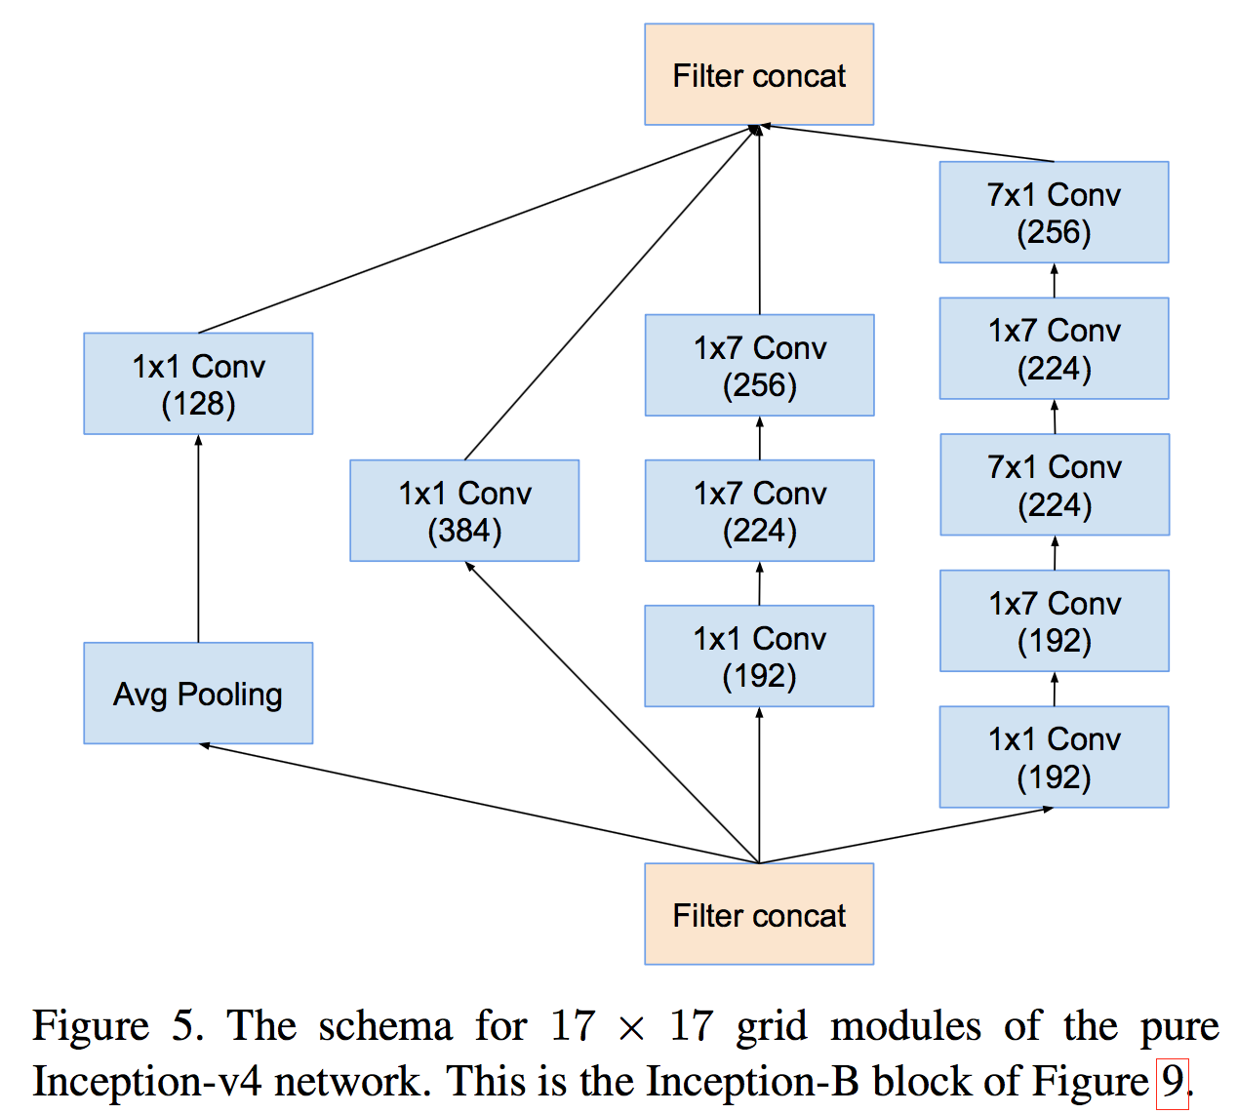
Inception v4

Slide 55
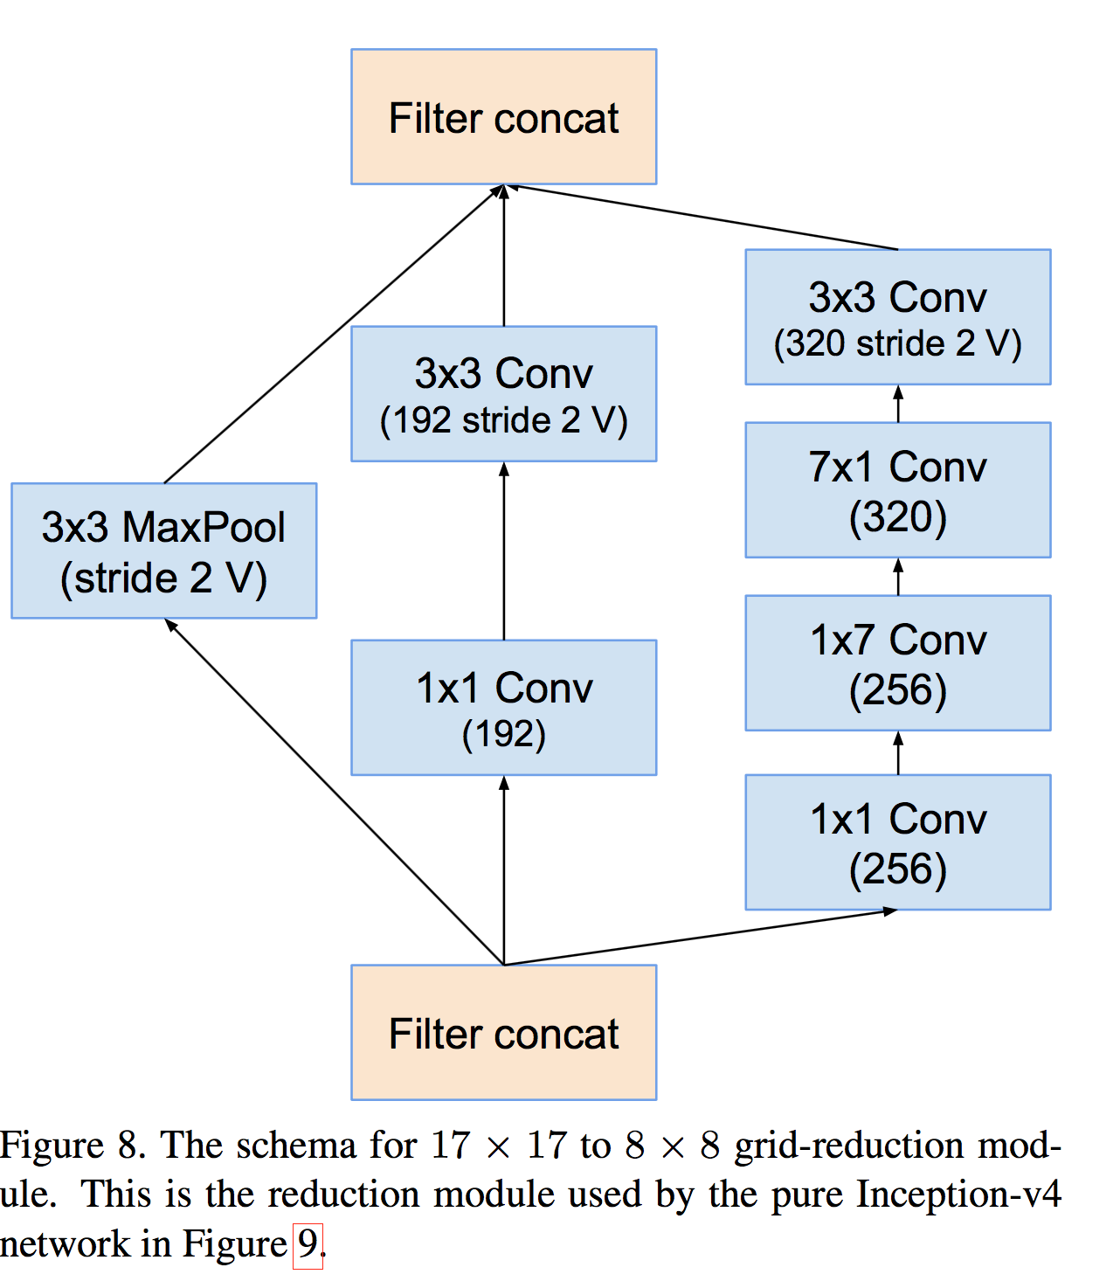
Inception v4

Slide 56
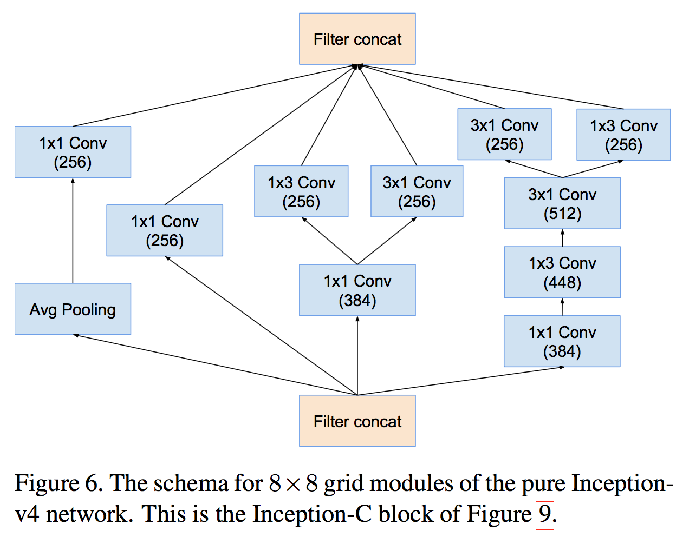
Inception v4

Slide 57
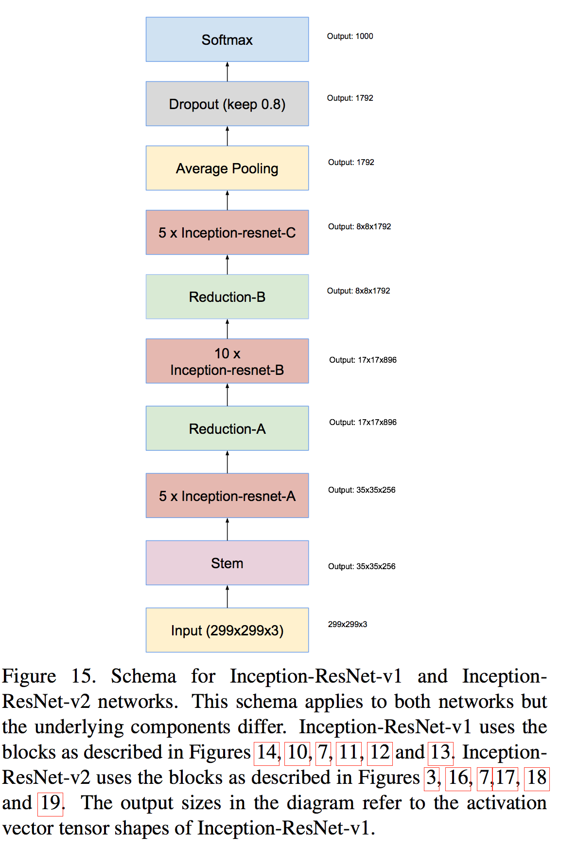
Inception-ResNet-v1

Slide 58
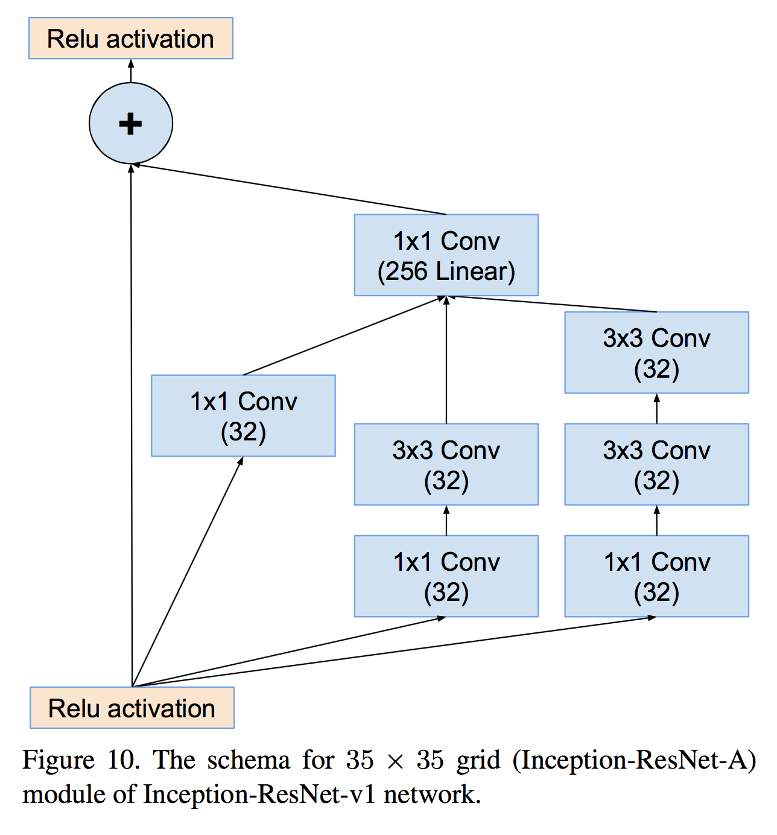
Inception-ResNet-v1

Slide 59
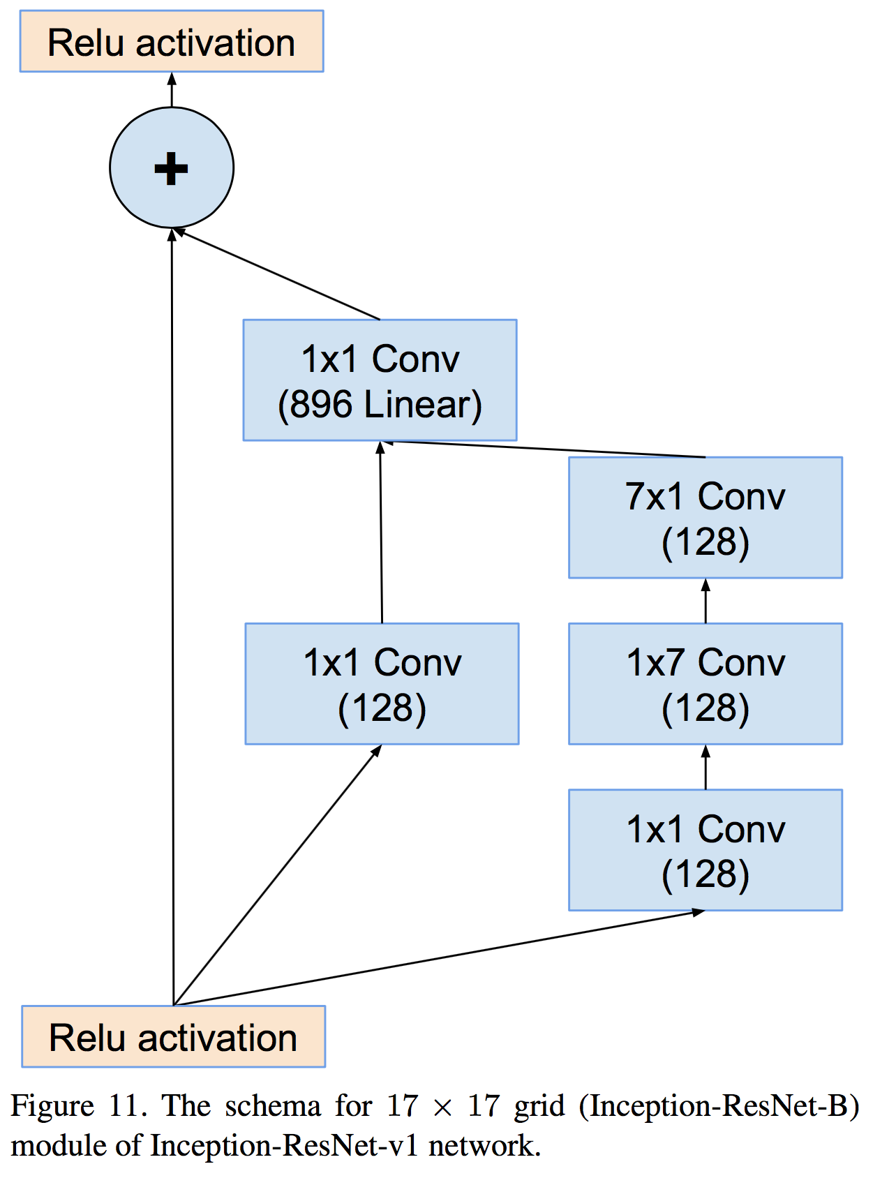
Inception-ResNet-v1

Slide 60

Inception-ResNet-v1

Slide 61
ResNet

Slide 62
Deep residual networks
152 layers network
1st place on ILSVRC 2015 classification task
1st place on ImageNet detection
1st place on ImageNet localization
1st place on COCO detection
1st place on COCO segmentation

Slide 63
Deeper Network?
Is deeper network always better?
What about vanishing/exploding gradients?
Better initialization methods / batch normalization / ReLU
Any other problems?
Overfitting?
Degradation problem: more depth but lower performance

Slide 64


Degradation problem
CiFAR 100 Dataset
ImageNet
Notes:
Ensemble -> 성능향상 : superset이 아님

Slide 65

Residual learning building block

Slide 66



Residual learning building block
y
ReLU
+
y
conv2d
y
ReLU
y
conv2d
x

Slide 67
Why residual?
We hypothesize that it is easier to optimize the residual mapping than to optimize the original, unreferenced mapping.
Shortcut connections are used.

Slide 68
Why residual?
“The extremely deep residual nets are easy to optimize. “
“The deep residual nets can easily enjoy accuracy gains from greatly increased depth, producing results substantially better than previous networks. “

Slide 69



Residual mapping
Basic residual mapping (same dim.)
“But we will show by experiments that the identity mapping is sufficient for addressing the degradation problem and is economical, and thus W is only used when matching dimensions.”
Basic residual mapping (different dim.)

Slide 70

Deep residual network

Slide 71


Deeper bottle architecture
Dimension reduction
Convolution
Dimension increasement

Slide 72


Experimental results

Slide 73

Experimental results

